Slide 1
Basic presentation
SALES AND CUSTOMER ANALYSIS REPORTS

Slide 2
Table of contents
Introduction
Objective
Case Problem
Insights and Recommendation
Case Problem
Conclusion

Slide 3

Introduction
In today’s data-driven business environment, organizations require clear visibility into their sales performance to make informed strategic decisions. However, raw transactional data alone does not provide sufficient insight into revenue trends, customer behavior, or the key drivers of business growth. This project was undertaken to transform sales data into meaningful, actionable insights that support effective decision-making.
As a Sales Data Analyst, I was engaged to analyze sales performance and develop interactive dashboards that provide management with a comprehensive view of business operations. The analysis focuses on understanding overall revenue performance, identifying growth patterns across time periods, evaluating product and regional contributions, and examining customer purchasing behavior.
The solution integrates three core datasets sales, customer, and product data into a unified analytical model using Microsoft Excel and Power Pivot. By connecting these datasets, the analysis enables a holistic view of sales activity across customers, products, and regions, ensuring accuracy, consistency, and flexibility in reporting.
To ensure clarity and usability, the findings are presented through two interactive dashboards. The Revenue Performance Dashboard delivers an executive overview of sales trends, key performance indicators, and comparative time-based insights, while the Customer and Product Insights Dashboard provides deeper analysis of customer contribution, demographic patterns, and product performance. Together, these dashboards are designed to help decision-makers quickly understand what is happening in the business, why performance is changing, and where strategic action is required.

Slide 4
Business Question
How much revenue did the business generate overall this year?
How many orders were placed, and what is the average order value (AOV)?
Which months had the highest and lowest sales, and are there seasonal trends?
Which customers generate the most revenue and/or place the most orders?
What is the revenue distribution across different age groups and genders?
Which product categories or individual products perform best and worst?
Which regions contribute the most and least to revenue and customer base?
Where are the opportunities for growth, and which areas or products need improvement?
How can management make data-driven decisions to improve sales, customer retention, and profitability?

Slide 5

poo
Objective
The goal of this project is to analyze sales data, uncover meaningful insights, and communicate findings through an interactive Excel dashboard.
The objectives of this analysis are to analyze:
1. Business Performance Analysis
2. Time-Based & Comparative Insights
3. Product & Category Insights
4. Customer Insights
5. Regional Performance Insights
6. Dashboard Design & Interactivity
Confidence-building strategies

Slide 6
Engaging the audience
Case Problem
Management requires a clear and reliable way to monitor sales performance across different dimensions, including time, customers, products, and regions. However, raw sales data alone does not provide sufficient visibility into revenue trends, customer contribution, or growth opportunities.
Key challenges addressed in this analysis include:
Limited visibility into overall revenue performance and growth trends
Difficulty identifying top-performing customers and products
Lack of insight into customer demographics and buying behavior
Inability to compare regional performance and identify expansion opportunities
Without structured analysis and visualization, these gaps limit effective sales planning, customer targeting, and resource allocation.

Slide 7
Data Processing and methodology
The data processing stage involved preparing and analyzing the raw datasets to extract meaningful insights and ensure accuracy for further analysis. This process encompassed several key steps:
Exploratory Data Analysis (EDA): The first step was conducting an in-depth EDA to understand the structure, patterns, and quality of the data. EDA involved:
Checking for missing or null values
Removing duplicates
Understanding data distributions and relationships between variables
EDA provided a foundation for informed decisions on handling data inconsistencies and shaping the dataset for visualization and KPI computation.
Tools Used: The analysis was carried out using Microsoft Excel, leveraging its data management and visualization capabilities. Power Pivot was used perform advanced calculations beyond standard Excel. DAX (Data Analysis Expressions) was applied to build relational models and compute key metrics for deeper analysis

Slide 8
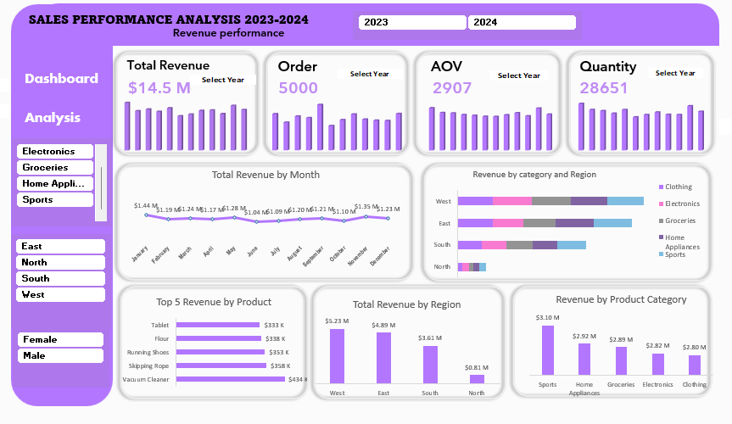

Slide 9
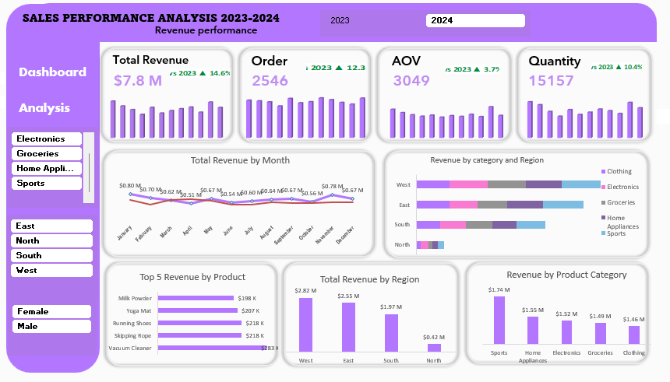

Slide 10
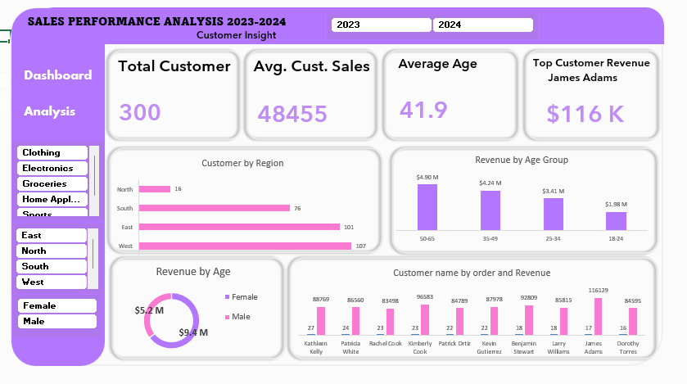

Slide 11
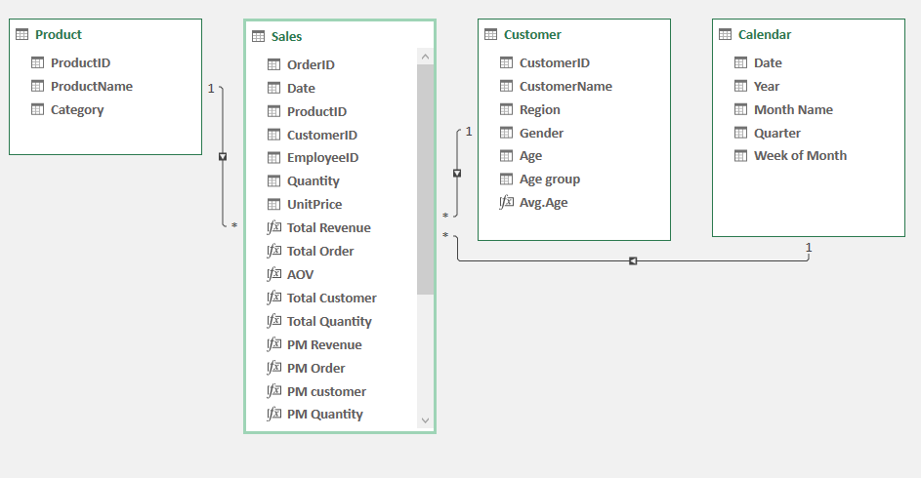
Data Modelling

Slide 12
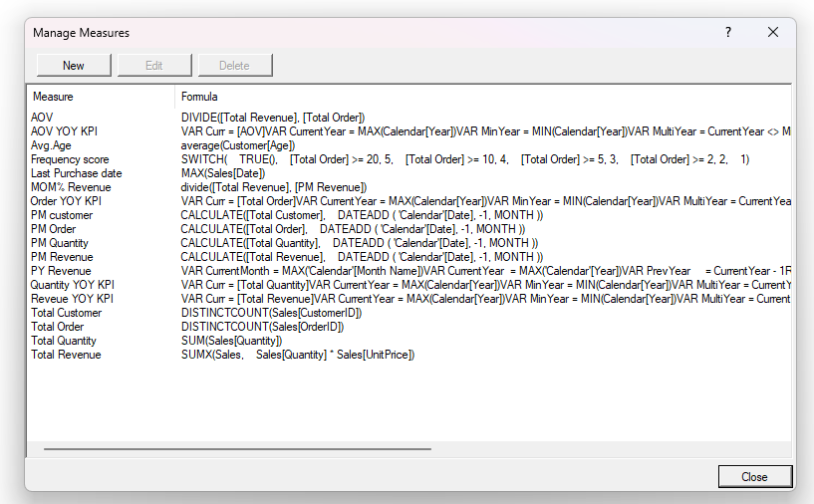
Dax Measures

Slide 13
Key Insights
Overall Business Performance:
Total sales reached ₦14.5M with 5,000 orders and an AOV of 2,907.
YoY growth shows sales increased by 14.6%, orders by 12.3%, and quantity by 10.4%, indicating strong business momentum.
Monthly / Time-Based Trend:
Peak month: January (₦1.44M) shows strong early-year demand.
Other strong months: November (₦1.35M) and May (₦1.28M) indicate seasonal buying patterns.
Low months: June (₦1.04M) and July (₦1.09M) suggest mid-year slow periods.
Sales remain relatively steady throughout the year, ranging from ₦1.04M to ₦1.44M, with minor seasonal fluctuations..
Product & Category Insights:
Sports category contributed the highest revenue (₦3.1M).
Clothing category is the lowest performer (₦2.8M), signaling potential need for pricing adjustments or marketing campaigns.
Top-performing products drive a large portion of revenue, highlighting focus areas for growth and inventory planning.

Slide 14
Key Insights
Customer Insights:
Female customers contribute ₦9.4M, compared to ₦5.2M from male customers, indicating women are the primary revenue driver.
Top revenue customer: James Adams ($116K, 17 orders)
Top order customer: Kathleen Kelly (27 orders, $88,769)
Insight: A small group of customers contributes disproportionately to revenue, which can inform loyalty and retention programs.
Regional Insights:
West region: highest revenue (₦5.23M) and customers (107).
East region: strong performance (₦4.88M, 101 customers).
North region: lowest revenue (₦0.81M) and customers (16), highlighting untapped market potential.
Regional comparison helps prioritize sales and marketing efforts geographically.
Revenue & Orders by Age Group:
50–65 years: ₦4.9M (highest revenue contributor)
35–49 years: ₦4.2M
25–34 years: ₦3.41M
18–24 years: ₦1.98M (lowest)
Older customers (35–65) generate the highest revenue, while younger customers contribute less in revenue.
Orders follow a similar trend, showing purchase frequency is higher in age group.

Slide 15
Speaking impact​
Recommendations
Target Customer Segments:
Focus marketing efforts on the 50–65 and 35–49 age groups, particularly female customers who contribute most of the revenue.
Top Customer Engagement: Implement loyalty programs and personalized offers for high-value customers like James Adams and Kathleen Kelly to retain revenue contributors.
Regional Strategy:
Expand marketing and sales efforts in North region to capture untapped potential.
Maintain strong support in West and East regions, aligning inventory with demand.
Product Strategy:
Invest more in Sports products.
Review and promote underperforming Clothing products.
Allocate high-demand products to regions where they perform best.
Seasonal & Promotional Planning:
Focus promotions and inventory for peak months (January, May, November).
Boost sales during slow months (June, July) using targeted campaigns, bundles, or discounts.
Customer-Centric Marketing: Tailor campaigns by age and gender, leveraging insights to maximize engagement and repeat purchases.
Data-Driven Decisions: Use the interactive dashboard for real-time KPI monitoring, sales forecasting, and strategic planning to optimize business growth.
o communicate effectively will leave a lasting impact on your audience​
Effectively communicating involves not only delivering a message but also resonating with the experiences, values, and emotions of those listening

Slide 16
Conclusion
The interactive sales dashboard provides a centralized view of the organization’s performance by combining sales, customer, and product data into actionable insights. It highlights key trends, including top-performing regions, high-value customers, strong product categories, and age and gender-based revenue patterns. By analyzing monthly and seasonal fluctuations, management can make informed decisions about inventory, promotions, and regional expansion. The insights and recommendations derived from this dashboard support data-driven decision-making, enabling the business to optimize strategies, improve customer retention, and identify growth opportunities. Overall, this project demonstrates how analytics can transform raw sales data into meaningful strategies that drive business success.

Slide 17
THANK YOU
THANK YOU
Email: salaubukola85@gmail.com
GitHub: https://github.com/salaubukola85-hub/Sales-Analysis-Dashboard
LinkedIn: https://www.linkedin.com/in/salau-bukola-783922289
Brita Tamm​
502-555-0152​
brita@firstupconsultants.com​
www.firstupconsultants.com

